Slide 1

Plant tissues and organs

Slide 2
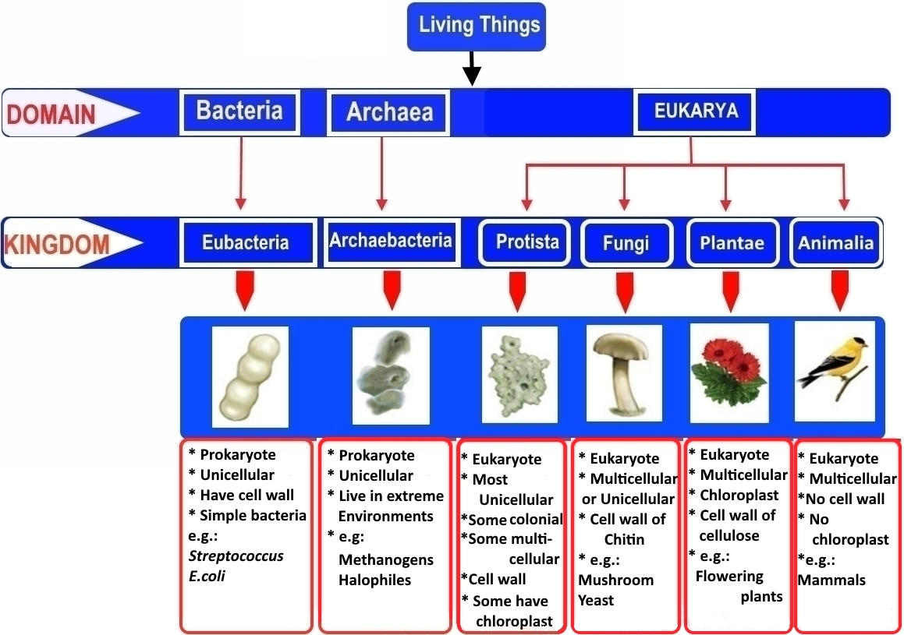

Slide 3
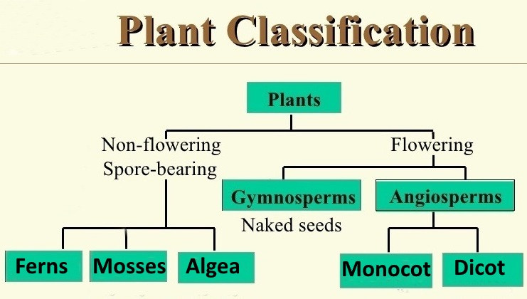

Slide 4
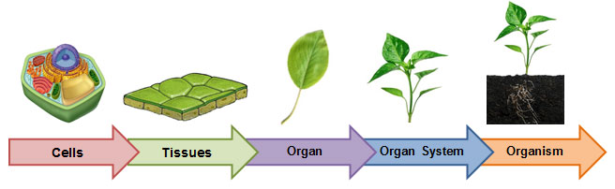
Tissue : a group of similar cells that are co-ordinate to perform the same function
Levels of organization in higher Plants and Animals

Slide 5
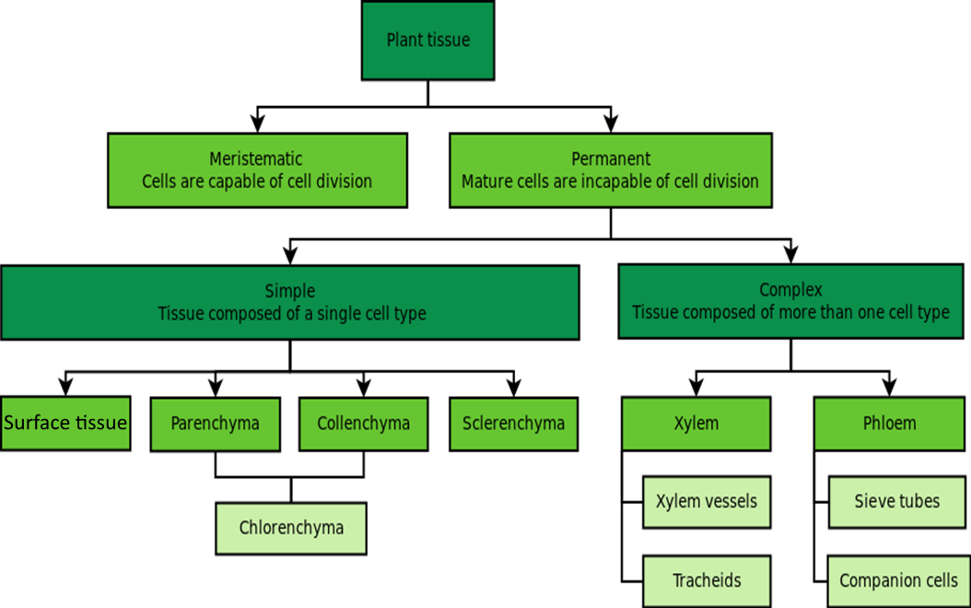

Slide 6
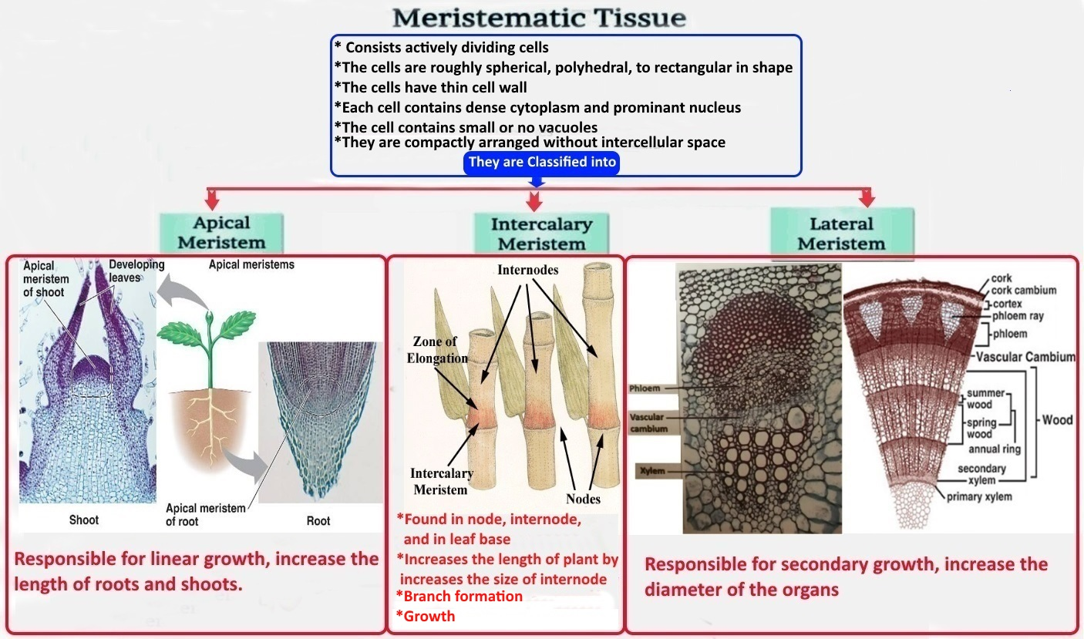

Slide 7
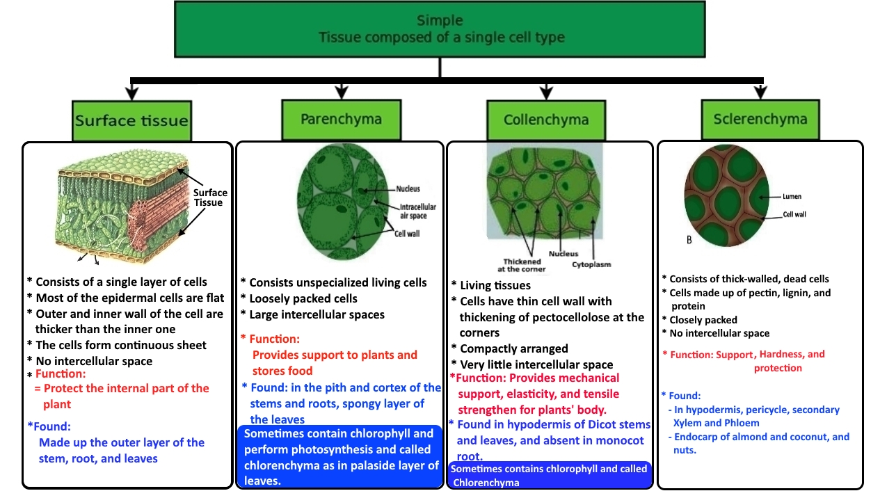

Slide 8
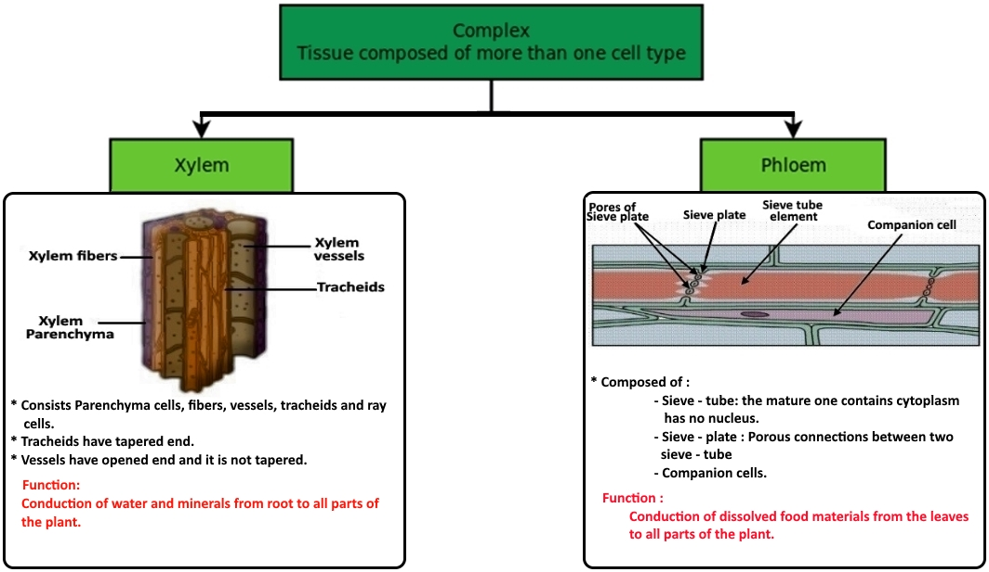

Slide 9
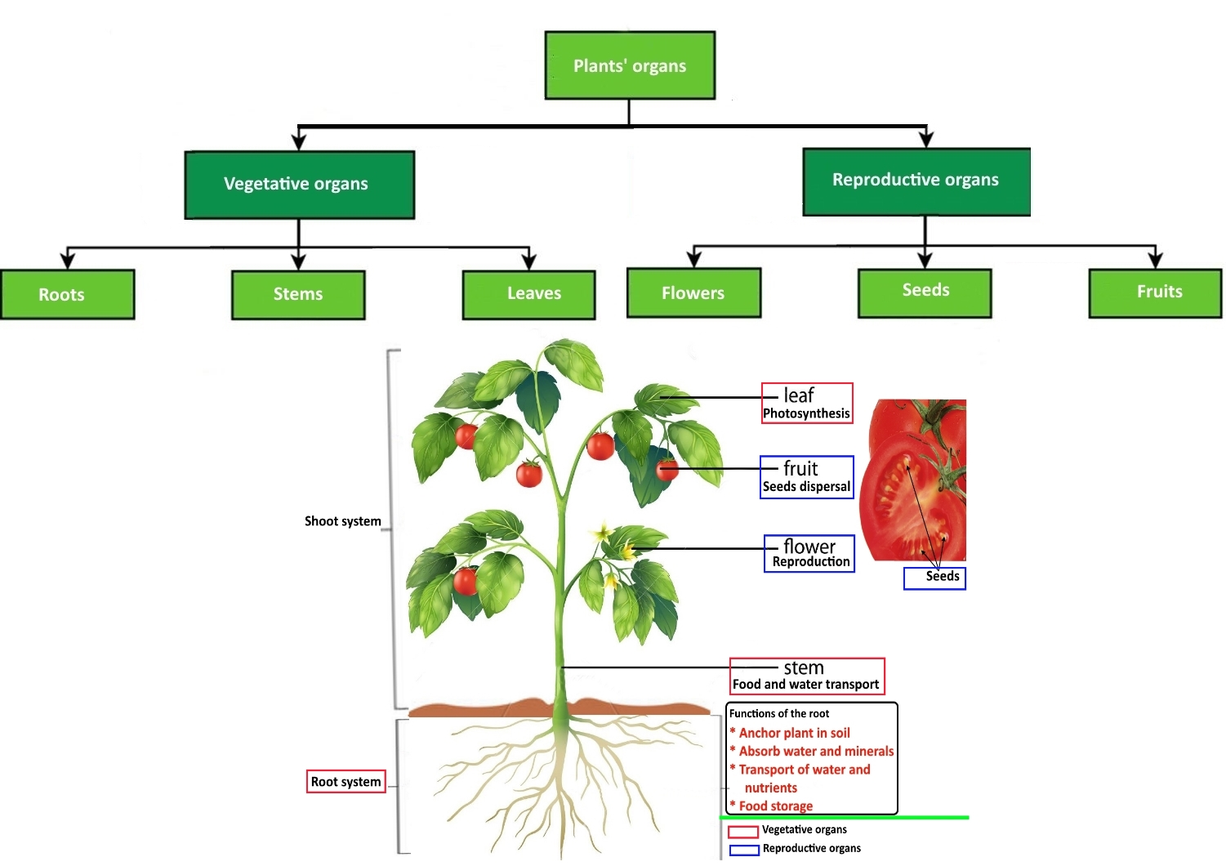

Slide 10
Roots: the non-leaf, non-nodes bearing parts of the plant's body that typically lies below the surface of the soil, some are aerial or aerating (growing up above the ground or especially above water). Functions: * Absorption of water and inorganic nutrients * Anchoring of the plant body to the ground, and supporting it. * Storage of food and nutrients. * Transport of water and nutrients * Vegetative reproduction. * Produce cytokinin to control the rate of shoot growth
Vegetative organs

Slide 11
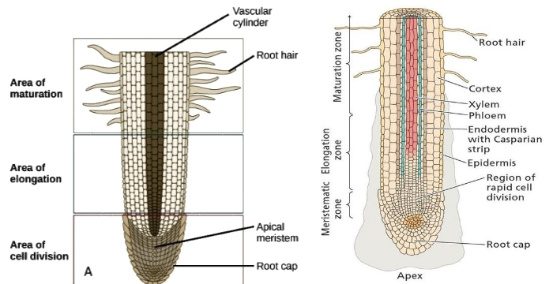
Structure of the Root:
Longitudinal sections
The root cap:
Formed by the lower portion of the apical
meristem
Direct the growing of the root downward by sense to the gravity
Protect the meristematic tissue
Secrete a slimy mucous-like substance that lubricates the root and make it’s movement between the soil particles more easier
Apical meristematic:
Compose of dividing cells that form the tissue of
other root regions

Slide 12
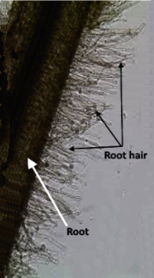

Region of elongation:
Cells elongate rapidly and undergo the final round
of cell division to for the endodermis
Some cell thicken to form casparian strip
Region of maturation (differentiation):
The cells mature and begin to change their structure
and their function
Root hairs: Long extension of epidermal cells are first form. They increase the surface area for water and minerals absorption by root

Slide 13
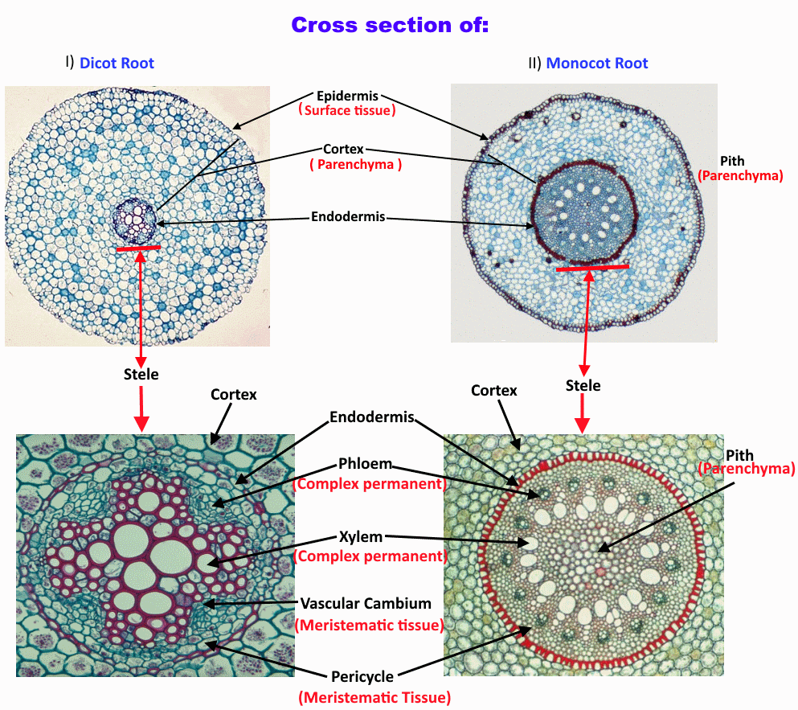

Slide 14
Dicot Root
Epidermis:
A single layer of cells on the outside that protects the inner tissues
Has no waterproof cuticle
Some of the epidermal cells of the root grow outward to form root hair
Cortex:
Consists of parenchymal cells
Store water and food
Facilitate the movement of water from the root hair on the outside to the xylem in the inside of
the plant

Slide 15
Dicot Root
Endodermis:
The innermost layer of the cortex
Tightly-packed layer of modified parenchyma cells
The radial and transverse cell walls are thickened with a water-impermeable, waxy suberin
layer ( Casparian strip )
Regulate the flow of water from the cortex into the stele
The Stele ( Vascular cylinder ):
Responsible for transporting water and minerals
Consists of:
The pericycle : the outermost layer of the stele, and consists of one or more rows of thin-walled
parenchyma cells
The Xylem : in dicot root is arranged in an ( X arch ) shape

Slide 16
The phloem tissues: lay between the arms
The cambium:
- Separates the xylem and phloem tissues from each other.
- Functions in the formation of the secondary growth of xylem and phloem tissues.
Some times Dicot roots contains Pith in the center of the stele, made up from Parenchyma

Slide 17
Monocot Root
Surrounded by epidermis
Ground layer differentiate into: Cortex, Endodermis, Pericycle, and Pith
Vascular bundle: made up from 8 or more alternate bundles of xylem and phloem arranged in an
alternate axis
No vascular cambium
No secondary growth

Slide 18
The differences between Dicot and Monocot Root
Monocot Root | Dicot Root
Pericycle produces only lateral roots. | Pericycle give rise to lateral root, cork cambium, and part of vascular cambium.
Number of xylem and phloem numerous (8 to many). | Number of xylem and phloem groups limited (2-6 or 8)
Xyelm vessels are oval or rounded. | Xylem vessels angular or polygonal in transverse section
Pith is large and well developed. | Pith is absent or very small.
No secondary growth. | There is secondary growth.
The conjunctive tissue is sclerenchymatous and doesn't produce vascular cambium. | The conjunctive tissue is parenchymatous and produces vascular cambium.

Slide 19
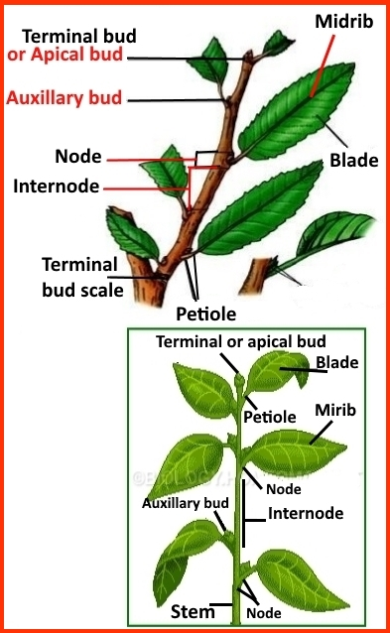
Stem Anatomy
Stem :
Develops from the plumule of the embryo
The lateral branches develop from the buds
Usually grow above the soil surface and towards the light
Stem either herbaceous stems (leafy non-woody structures) or
woody stems
The main functions of stems are:
Support for the plant as it holds leaves, flowers and fruits upright above
the ground
Transport of fluids between roots and shoots in the xylem and phloem
Storage of nutrients
Production of new living tissue: stems contain meristematic tissue that generates new tissue

Slide 20
Nodes and internodes are regions found on the stem Nodes: are the regions from which leaves and lateral branches develop Internode : is the region between nodes

Slide 21
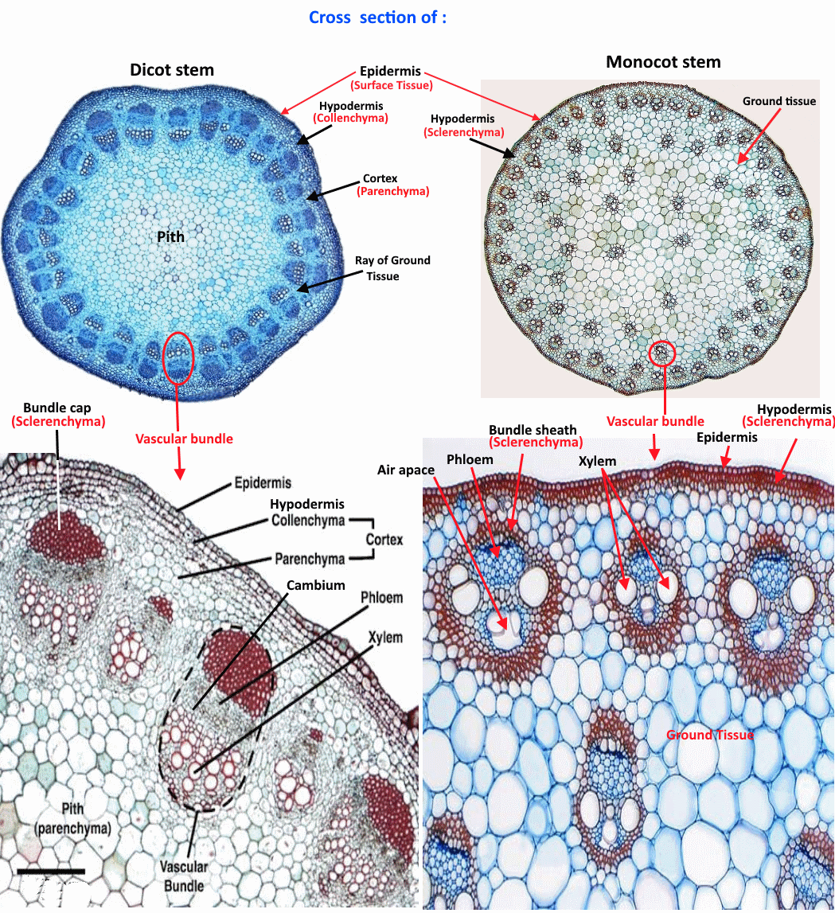

Slide 22
Stem anatomy
Cross section of Dicot stem
1- Epidermis: single layer of living closely packed cells.
- Lenticels & guard cells are present
- The walls are thickened and covered with a thin waterproof layer called the cuticle
- In some cases, a uni- or multicellular hair like outgrowth appears
- FUNCTION: protection, prevent desiccation of inner tissues and water loss
Lenticels : allow gaseous exchange
2- Hypodermis: a few layers of collenchyma cells that found beneath the epidermis.
3- Ground tissue: in dicots, differentiate into cortex, endodermis, pericycle, medullary rays & pith

Slide 23
4- Vascular Cylinder /Stele:
- Pericycle: made up of lignified sclerenchyma cells (dead fiber cells). These cells have
thick, woody walls and tapering ends.
The function of Pericycle are: Strengthens for the stem and protection for
the vascular bundles.
- Vascular bundle:
- Situated in ring around the pith and to the inside of the pericycle.
- Mature vascular bundle consists three main tissues: xylem (inner), phloem
(outer) and cambium (between them).

Slide 24
Pith (medulla): occupies the large central part, parenchyma with intercellular spaces.
Functions of the Pith or Medulla:
o The cells of the pith store water and starch.
o They allow for the exchange of gases through the intercellular air spaces.
o The medullary rays transport substances from the xylem and phloem to the inner and outer parts of the stem.
- Medullary rays: are bands of parenchyma located between the vascular bundles &
continuous with cortex & pith

Slide 25
Cross section of Dicot stem : ** Epidermis : - The walls are thickened and covered with a thin waterproof layer called the cuticle - In some cases, a uni- or multicellular hair like outgrowth appears ** Hypodermis : - Made from compactly arranged sclerenchyma without intercellular spaces - Provides mechanical strength to the plant

Slide 26
** Ground Tissue :
- Made up from parenchyma cells
- Not differentiated into cortex, endodermis, pericycle and pith
- Compactly arranged (toward center) or loosely arranged (toward peripheral)
- Vascular bundles are randomly scattered in this tissue
- Functions:
Store synthesized organic food
Intercellular air spaces allow the exchange of gases

Slide 27
** • Vascular bundles :
- Vascular bundles are randomly scattered in this tissue
- It has two types:
A) Larger and smaller lie towards the center (less in number)
B) Smaller towards and periphery (more in number)
- Contain no cambium, So, no secondary growth
- Composed of:
Sclerenchyma sheath:
** Thick-walled sclerenchyma fibers surround the vascular bundle
** Protect the vascular bundles and strengthen the stem.

Slide 28
Xylem :
** Consists of vessels, tracheid, xylem parenchyma and limited xylem fibers
** A large water cavity is present in the inner side of the protoxylem that store water
Phloem:
** Lies outside the xylem in the vascular bundle
** It consists of sieve tubes, companion cells and phloem fibers, but lacks phloem parenchyma

Slide 29
The differences between Dicot and Monocot stems
Monocot stem | Dicot stem
Epidermal hairs absent | Multicellular epidermal hairs may or may not be present
Hypodermis is generally sclerenchyma | Hypodermis is generally collenchyma
Concentric arrangement of tissues is absent | The different tissues are arranged in concentric fashion
No differentiation except hypodermis | Differentiated into hypodermis, cortex, endodermis, pericycle and pith
Solid or hollow | Always solid
Vascular bundles are of different sizes | Vascular bundles are of similar size
Vascular bundles are Oval or rounded, numerous and scattered in the ground tissue | Vascular bundles are wedge shaped, definite and arranged in one or two rings
Bundle sheath Present | Bundle sheath absent
Vascular bundle are closed | Vascular bundles are open
The cavity in the vascular bundles is present | No cavity in the vascular bundles
Phloem parenchyma absent | Phloem parenchyma present
Secondary growth is generally absent | Secondary growth occurs due to formation of lateral meristem
No vascular cambium | There is vascular cambium

Slide 30
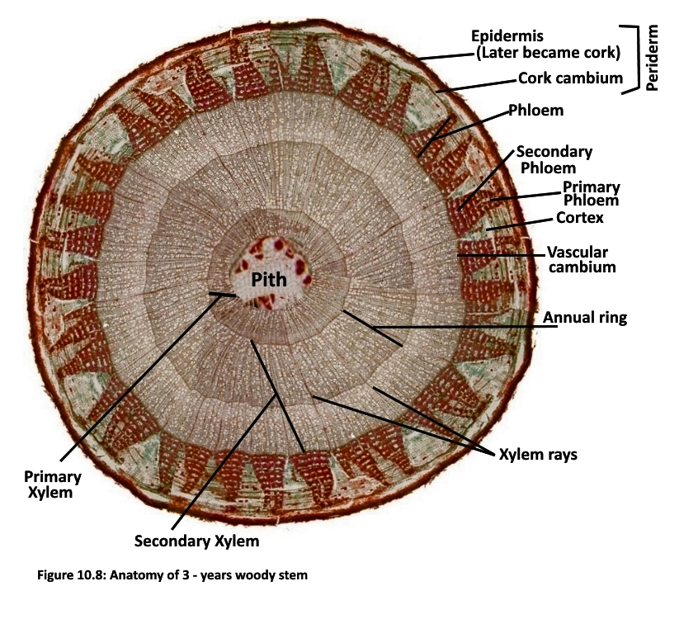
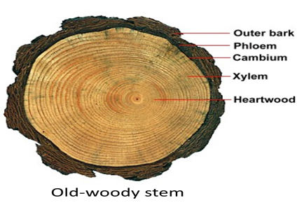
Woody Dicot stem

Slide 31
Cross section of 3- years Woody Dicot stem
Cross section of 3- years Woody Dicot stems consist:
The bark : The outermost layers of the stems and roots of the woody plants, it consists:
** Primary and secondary phloem
** Cortex
** Periderm : Consists:
Cork :
- An external layer of secondary tissue that produce by Cork cambium
- Cork cell walls contain suberin that:
1- protects the stem against water loss
2- prevents the invasion of insects into the stem
3- prevents infections by bacteria and fungal spores

Slide 32
Periderm :
- The cork cambium : one cell layer thick and it divides to the outside producing cork
- Phelloderm :
- A layer of cells formed by and interior to the cork cambium
- Not always present in all barks
Vascular cambium : lateral meristems. The vascular cambium continually adds new secondary xylem to the
outside of the existing xylem and the new secondary phloem cells are added to the inner
part of the ring of phloem.
Xylem: - Cambium a layer of secondary xylem and a layer of secondary phloem
- Xylem makes up the wood region and arrange in rings called annual ring
- Each annual ring represents one year

Slide 33
Xylem:
- Each annual ring contains two sub ring, the spring and summer rings
- The xylem vessels made in the spring, when water is plentiful, have larger diameters than
those made summer
Pith :
- Young stems have pith that made of parenchyma to stores food
- Old woody stem have no pith

Slide 34
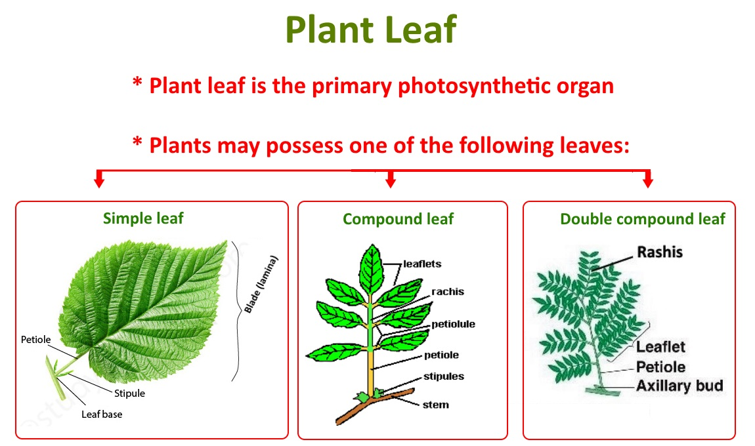

Slide 35
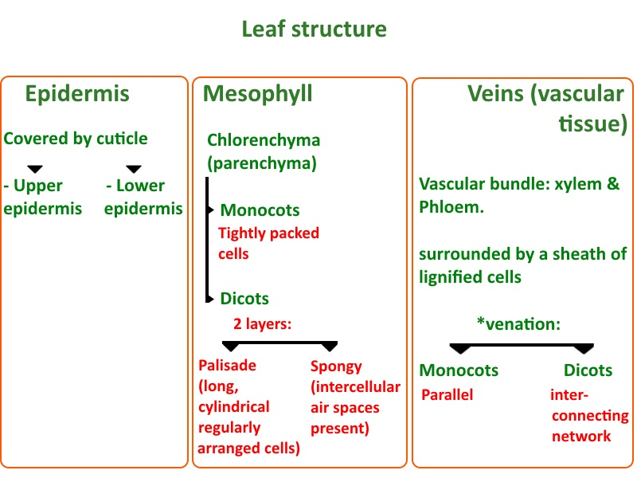
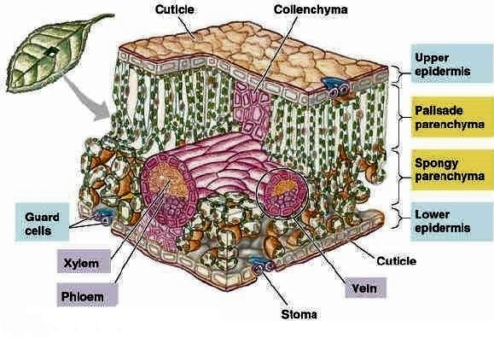
Internal leaf structure

Slide 36
Epidermis: the outer layer of cells covering the leaf
** It’s coated by waxy Cuticle which is impermeable to liquid water and water vapor
**Functions:
- prevent desiccation.
- regulates gas exchange,
- secretion of certain metabolites
- water absorption (in some plant species)
- protection against water loss by way of transpiration

Slide 37
** Structure: the epidermal layers includes the following differentiated cells;
Epidermal cells (the largest, most numerous & least specialized). Epidermal cells are more elongated in monocots than in dicots.
Hair cells (trichomes)
Stomatal complex cells (guard cells (chloroplasts present), and subsidiary cells (lack))
- Stomatal complex regulates the opening and closing of stomata.
- Stomata are more numerous over the lower epidermis than the upper epidermis and
regulate the gases exchange.

Slide 38
Mesophyll: Form Most of the interior of the leaf between the upper and lower layers of epidermis In dicot leaves, the mesophyll is divided into two layers
Palisade layer:
** directly beneath the upper epidermis
** cylindrical cells, arranged in 1-5 rows,
** Parechyma cells that contain chloroplasts ( Chlorenchyma )
Spongy layer:
** beneath palisade
** the cells are NOT tightly packed (there is intercellular air spacesfor oxygen and
carbon dioxide to diffuse in and out of during respiration and photosynthesis)
** have fewer chloroplasts than the cells in the palaside layer
** The pores of stomata opens into sub stomatal chambers, which are connected
to the air spaces, thus, CO2 and O2 can diffuse in & out during respiration &
photosynthesis

Slide 39
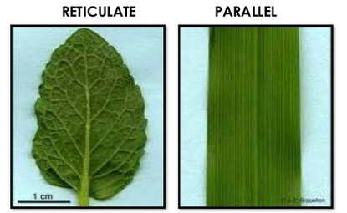
3- Veins:
** Made up of the vascular tissue (vascular bundle) of the leaf, located in the spongy layer.
** Structure : Xylem, Phloem (in the core) & a sheath of lignified cells surrounding the
vascular tissue.
- This sheath strengthen the rigidity of leaves.
** The pattern of the veins is called venation
(parallel in monocots, reticulated in dicot)

Slide 40
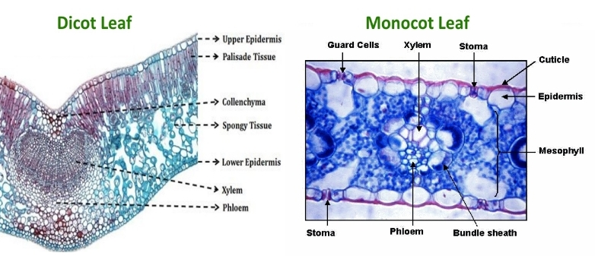

Slide 41
The main differences between Dicot and Monocot leaves
Monocot leaf | Dicot leaf
Symmetry: Isobilateral | Symmetry: Dorsoventral
Stomata distribution: Amphistomatic (stomata equally distributed on both the surfaces). | Stomata distribution: Hypostomatic (stomata found mainly in the lower surface).
Mesophyll: Only spongy parenchyma is present with small intercellular spaces. | Mesophyll made up of Palisade and spongy Parenchyma with large intercellular spaces.
Bundle sheath: Made of parenchyma but just above and below the vascular bundles are found sclerenchymatous cells( up to epidermis) | Bundle sheath: Made of parenchyma. Just above and below the vascular bundles some found Parenchymatous and Cllenchymatous cells are present up to epidermis.
Veins are parallel arranged | Veins are irregularly ( Net ) scattered

Slide 42
Reproductive organs
Plant reproductive organs are: 1) Flowers, 2) Fruits 3) Seeds
Plant reproductive organs are responsible for the continuation of a given species, by
propagation.
The Flower is the reproductive unit in Angiosperms.
The flowers of different plants are varied according to shape, size color & number &
arrangement of flower parts.

Slide 43
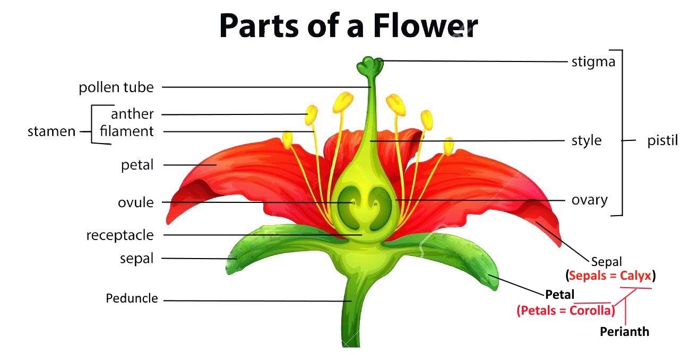
Floral parts
1) Vegetative, or accessory, part (Perianth)
- Calyx: on the outermost whorl, consist of sepals. They may be absent or prominent & petal-like
- Corolla: the next whorl toward the apex, consist of petals, that are colored to attract animals (insects) that help in pollination process.
2) Reproductive parts
- Stamens (male part): each one consist of filament and anther (pollen is produced there)

Slide 44
- Pistil (female part): it consist of carpels, & each carpel consist of: ovary (encloses the ovules or potential seeds), style (upright extension), & stigma (pollen receptive surface).
* A pistil may be simple (with a single carpel), compound (consist of several carpels joined together), or ovule bearing modified leaf.

Slide 45
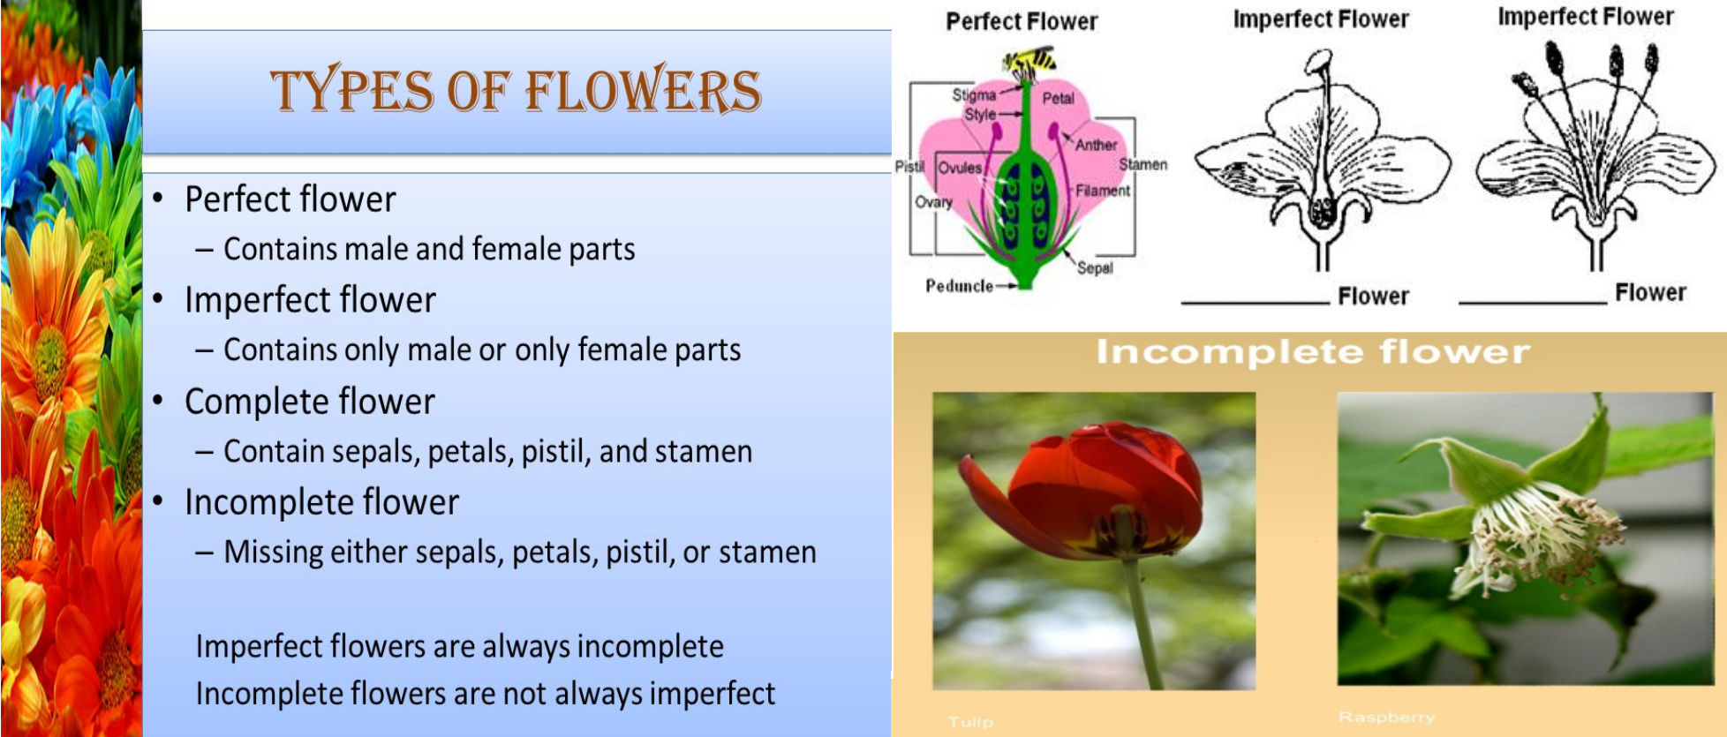

Slide 46
Plants with perfect flowers are said to be monoecious plants
- (both pistil & stamen present in the flower).
Plants with imperfect flowers are said to be dioecious plants
(its flowers has either pistil or stamen).
- A flower that lacks stamens is called pistillate or female
- A flower that lacks pistils is called staminate or male

Slide 47
The Practical part
1- Study available model of Dicot Root, Dicot Stem, Monocot Stem, Vascular bundle ( Xylem ),
Dicot leaf, and Flower
2- Study available prepared slide of Dicot and Monocot Root, Dicot and Monocot Stem, Root hair,
Old woody Stem and Dicot Leaf.
3- Identify all parts you see in the models and prepared slides, and then identify the Plant tissue made
up these parts.
4- Study a fresh stem to determine all of its external parts.
5- Study compound and simple fresh leaves.
6- Study a fresh flower and determine all parts.

